Slide 1

Part Three Making Sense of Society
2022.4.20

Slide 2
Making Sense of Society
9. Cognitive Structures of Attitudes
10. Cognitive Processing of Attitudes
11. Stereotyping: Cognition and Bias
12. Prejudice: Interplay of Cognitive and Affective Biases
When people consider their social context, their attitudes about issues and their reactions to social groups inform their sense of their place in society. People’s attitudes rapidly or deliberately evaluate relevant objects in each person’s surroundings, serving several adaptive functions to guide responses. Stereotypes represent social groups, and prejudices drive emotional reactions to them.

Slide 3
Cognitive Structures of Attitudes
Newer Approaches Build on Early Insights
Cognitive Representation Foreshadowed in Two Consistency Theories
Representations Can Be Discrete versus Distributed
People Have Lay Theories about Attitude Change
Functional Dimensions of Attitudes
Attitude: Attitudes categorize a stimulus along an evaluative dimension. As such, attitudes dispose people to react positively or negatively, as inferred from their cognitive, affective and behavioral responses

Slide 4
Newer Approaches Build on Early Insights
Early in the 20th century, Gordon Allport (1935) declared attitudes to be “the most distinctive and indispensable concept in contemporary American social psychology”.
The field sprang from various attitude research motivated by World War II:
Propaganda and persuasion (Hovland, Janis, & Kelley, 1953）
Anti-Semitic and antidemocratic prejudice (Adorno, Frenkel-Brunswik, Levinson, & Sanford, 1950)
Satisfaction and deprivation in the military (Stouffer, Suchman, DeVinney,
Star, & Williams, 1949)
Notes:
宣传和说服
反犹太主义和反民主偏见
军事中的满足感和剥夺感

Slide 5
Comparing Older and Newer Cognitive Approached to Attitudes
The newer cognitive approaches build on the older attitude theories in several crucial respects. ( variables, methodological procedures, research paradigms)
But the older and newer approaches also differ
First are metatheoretical differences between the two
Second, specific theoretical differences distinguish the older and newer approaches.
Third, many new methods for studying attitude change have evolved in directions borrowed from cognitive psychology.
Consistency theories → a drive to reduce internal discrepancies
Cognitive approaches → based on current understandings of the cognitive system
Notes:
现在的研究经常会用到很早之前的实验设计，改变主要就是增加了一些对干预认知过程的更详细的分析。
First:传统的一致性理论假定人们解决差异是为了避免持有两种相互冲突的信仰而产生的不适感,保持人们认知之间的一致性 （自洽理论）
例如，为了处理不一致性，当前的认知方法可能会假设人们解决差异主要是为了提高记忆存储的效率。
Second:较新的方法得到了早期无法获得的认知理论。这些理论有可能提供精确的框架，从而更仔细地分析与态度变化相关的认知过程。

Slide 6
Cognitive Representation Foreshadowed in Two Consistency Theories
The consistency theories of attitudes proposed in the late 1950s predicted the interplay
between attitudes and cognitive representation
Consistency is describe as the “compatibility of many simultaneously transpiring mental process”. When the relationship between intrapsychic processes and states are harmonious, there is a state of consistency.
The human mental system strives to avoid inconsistency and develops various mechanisms to move from a dissonant, inconsistent state to a more harmonious state.
https://www.thescienceofpsychotherapy.com/consistency-theory/
Notes:
“多个同时发生的心理过程的相容性” “当心理过程和状态之间的关系是和谐的”
对于每种情况，书中首先简要回顾最相关的一致性理论作为背景，然后描述当前的认知解释。

Slide 7
Dissonance Theory Predicts Selective Perception
Dissonance theory analyzes inconsistency among cognitions to describe how beliefs and behavior change attitudes. In this view, inconsistency causes a motivational state called dissonance.
The drive to reduce that arousal (discomfort) consequently makes you rearrange your cognitions to reduce dissonance.
Most ways to increase consistency is to rearrange cognitive representations
Add or subtract the cognitions (change your beliefs)
Reduce the importance of dissonant cognitions
Notes:
第一段结束：如果你相信吸烟会导致癌症（一种认知），但你还是吸烟（一种关于行为的相互矛盾的认知），那么你就容易产生认知失调 cognitive dissonance.
第二段结束：虽然理论上人们可以通过改变自己的行为来减少不一致性，但大多数不一致性研究关注的是不一致的认知何时更有可能改变。由于行为收到现实的约束，所以相较于认知和态度会更难被改变
赞同自己吸烟：烟品尝起来很好，很放松 不赞同：吸烟得癌症，烟很贵，其他人不喜欢我抽烟。Reduce the importance: 反正我早晚都会死，吸烟也无所谓

Slide 8
Selective Perception
Consistency theorists in general posit that people seek out, notice, and interpret data to reinforce their attitudes.
Dissonance theory in particular predicts that people will avoid information that increases dissonance.
Dissonance effects on selective perception divide into
selective exposure (seeking consistent information not already present),
selective attention (heeding consistent information once it is there)
selective interpretation (translating ambiguous information to be consistent)

Slide 9
Dissonance Theory Predicts Selective Learning
Selective learning and retention of attitudinally favorable information do occur under special conditions, defined in part by the contingencies of information processing
Incidental learning, rather than intentional learning. That is , people are more likely to be selective when they do not know they will be tested on the material later.
Balance Theory Predicts Selective Recall
Balance theory differs from dissonance theory in that it intrinsically concerns relationships between people
People learn and generate balanced social structures more easily than imbalanced ones

Slide 10
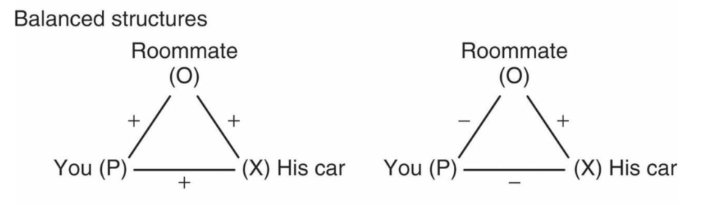
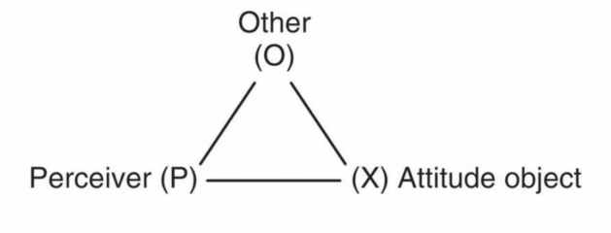
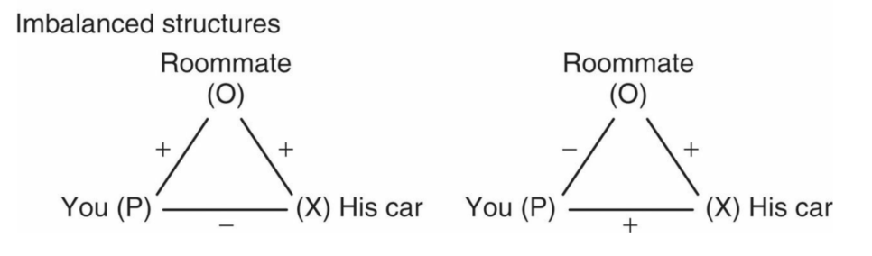
Basic cognitive structure

Slide 11
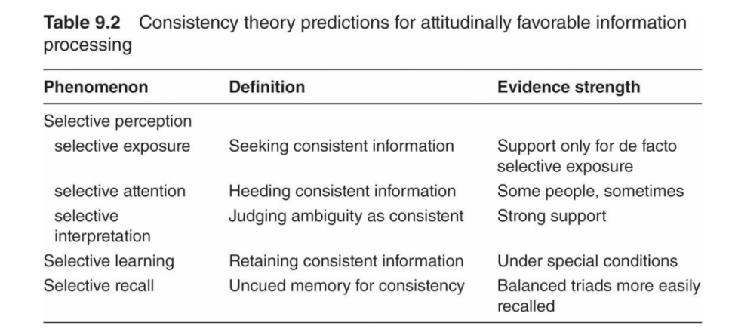

Slide 12
Attitudes Organize Memory
Making an attitudinal judgment improves recall of attitude-relevant evidence and creates attitude-consistent inferences.
The overall attitude is easier to recall than its supporting evidence
When people’s attitudes change, they retain both the old and new attitude in memory, as the old attitude seems to go underground.
Dual attitudes comprise an older, automatic attitude and the newer, explicitly accessible attitude. The older attitude may pop out unawares when one responds automatically or under cognitive load.
Notes:
前两段结束：如果知道这个人是一位飞行员，你就会记住它有很好的视力，并能够推断他有良好的空间能力
这些共存的态度产生了微妙的矛盾心理，破坏了信心，扩大了对利弊的考虑，并在时间压力下自动形成了中立的态度。

Slide 13
Representations Can Be Discrete versus Distributed
Distributed, procedural representations operate in parallel processes of attitude generation and response, are not just representations but also attitude processes, especially for generating attitudes.
Discrete, declarative representations operate in serial processes of attitude-relevant categorization, reasoning, and deciding, account well for higher-level thinking about attitudes
Notes:
用小单位代表了态度

Slide 14
People Have Lay Theories about Attitude Change
People’s everyday social theories about why attitudes change ( and do not change ).
One approach examines people’s ideas about the communicator’s social context, as it influences the perceived validity of the message.
Another examines information and arguments that arise when a group discuss an issue.
A third approach examines people contemplating their attitudes alone and applying their own theories about attitude change to that context.
Notes:
第三种方法考察了人们独自思考自己的态度，并将自己关于态度变化的理论应用于这种情况。

Slide 15
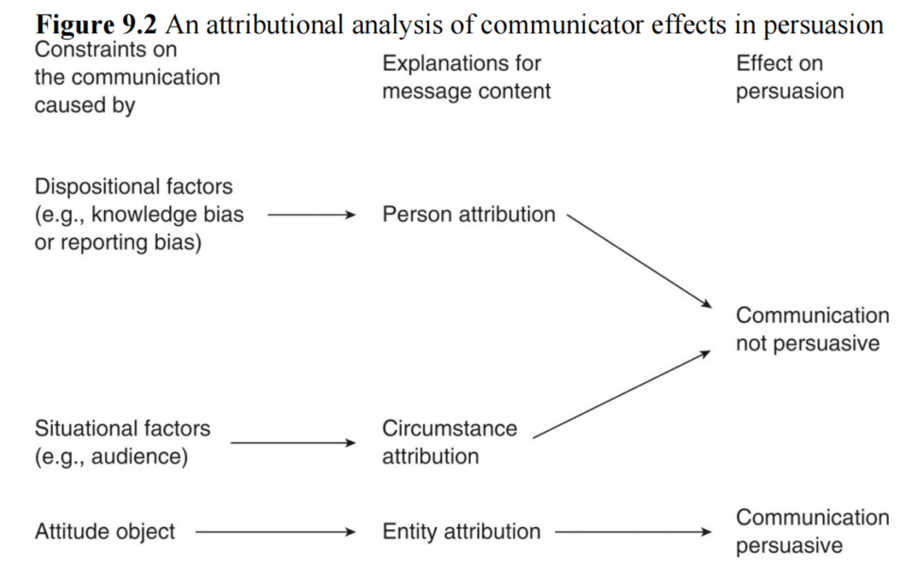
Attributional Analyses of Communicators and Their Messages
One early manifestation of social cognition research influencing attitude research came from attributional approaches to communicator credibility
Notes:
当绿色和平组织主席向当地的绿色和平组织发言时，你知道他自己的观点(dispositional factor) 和他的听众的观点（situational factor）都预先倾向于接受他的观点。
如果像英国石油这样的大型石油公司的总裁向其他行业主管提出同样的环保主义观点，那么他的信息确实是可信和有说服力的。
可以总结成与相关事件无关或对立的人提出相同的观点更可信。

Slide 16
Communicator attractiveness also profits from an attributional perspective
An unexpected position – given the communicator’s self-interest – increases perceived trustworthiness and accuracy, so it decreases message processing, resulting in heuristic agreement.
People not only believe that an agreeing source is credible; they also misattribute agreeable positions to credible sources → The heuristic implies that firm beliefs come from good sources.
People have lay theories about how components of attitudes should fit. Attributional analyses clarify various communicator variables interacting with message and context variables.
Notes:
一项研究测试了有吸引力的沟通者是否不仅在总体上更具说服力（这是一个公认的发现），而且在他们倡导不受欢迎的立场时尤其具有说服力
大学生就业机会、疾病的传播
如果这个说法是正确的，那么支持这个说法的所有论据就都是正确的

Slide 17
Group Polarization: Social Cognitive Explanations
Group polarization: the tendency for groups to show a shift towards the extremes of decision-making when compared to decisions made by individuals → groups will polarize toward the attitudes held before the group decision is reached.
Some of the explanations relied on traditional variables such as norms and values (normative influences), but one relied on a cognitive interpretation of the froup interaction (informational influence).
Persuasive arguments theory proposed that attitudes in groups polarize toward relatively extreme alternatives when people are exposed to new information
Social comparison theory: choice shift can be produced simply by information about others’ positions
Notes:
Group decision-making
假设你在竞选一个职位，你希望投票者一起讨论之后进行投票还是直接个人投票？
在有凝聚力的群体中，人们会觉得自己受到了保护，免受风险决策的影响；可以躲在团队的后面
当听到别人与自己类似但更极端的观点时，他们就倾向改变自己的观点。温和中立的立场被讨论淹没，形成了鼓励极端立场的状况

Slide 18
Implicit Theories about Attitude Stability and Change
Self-perception theory: when uncertain about their attitudes, people infer their attitudes from their own behavior.
People perceive their initial attitudes to be similar to their current (changed) attitudes, and they claim not to have changed.
Attitudes toward social categories in general are expected to be stable across the life span, but attitudes toward one’s own age group and its typical activities are expected to change with age (people do not expect attitudes toward skateboards to be stable across the life span)
Notes:
我自己本身不了解自己对心理学是否感兴趣，但是我选择了这门课，就说明我是对心理学是感兴趣的，但本身没有感兴趣的感觉
一个结果是，人们可能会歪曲自己先前的态度。被说服改变立场之后，人们可以很方便地感觉到他们的态度从未改变过。例如回想一下五年前自己对于心理学这门专业的看法
一般来说，人们轻视他们遥远的过去并赞扬最近过去的自我，相信他们过去到现在有很大的进步

Slide 19
Summary of Lay Theories of Attitudes
We have seen three approaches that rely on people’s own ideas about attitude change. The first examines the communicator’s motives, in order to infer the credibility of the information given. The second examines people’s ideas about the information they receive in groups, both information about other people’s positions relative to their own and information about the topic. The third examines people’s naive theories about their own attitude change processes. All three involve people using their own social theories to reflect on the social circumstances of their attitudes.

Slide 20
Functional Dimensions of Attitudes
Some classic theories differentiated motivational functions of attitudes and attitude change
Compliance to gain rewards and avoid punishments
Identification and conformity to enhance belonging with valued groups
Internalization to store attitude-relevant knowledge
Some of theses functional approaches focus on conviction, strength, and importance, which certainly have motivational components, and others specify particular attitude functions
Notes:
遵守法规以获得奖励并避免惩罚
识别和整合以增强对有价值群体的归属感
内化以存储态度相关知识
Conviction 信念

Slide 21
Conviction, Strength, and Importance
Conviction includes (Abelson, 1988) emotional commitment; attitudes that people hold with conviction are those about which they feel absolutely correct, cannot imagine ever changing their minds, have a moral sense, and feel committed.
Attitude strength includes various interrelated components. For example, importance and certainty both predict attempts to persuade others.
Attitude importance - a person’s interest or concern about an attitude – predicts information seeking. Important attitudes are stable, accessible, and allow one to differentiate among relevant objects.
Notes:
态度强度在中年前会增加，然后下降，这意味着年轻人和老年人最容易改变他们的想法，因为他们觉得自己的态度不那么重要和确定
例如，一位候选人重要的政治态度 （福利、战争、移民），与态度不重要的人相比，可以更好的辨别出他们在这个问题上的差异

Slide 22
Attitude Functions
Attitude functions can be divided in a few ways. Here we split them into knowledge, values, and sociality . These newer approaches explicitly incorporate motivation, reexamining traditional theories of attitudes’ motivational functions, but with new cognitive twists.

Slide 23
Knowledge Functions
The most fundamental attitude function is an object-appraisal function, which prominently includes a cognitive knowledge function and often an instrumental, utilitarian, or goal function.
The knowledge function of an attitude is fundamentally cognitive and adaptive. Attitudes help people to make sense of the world, to order and organize it.
Moreover, attitudes can have instrumental and adaptive functions, helping people to avoid pain and receive rewards.
Attitudes affect a range of knowledge-related problem-solving activities: interpretation and explanation, reasoning, responses to persuasion, judgment, perceived consensus, identification of facts and errors, and prediction.
Notes:
态度的对象评价功能可以作为启发式，这是解决问题的简单评价策略。例如，态度有助于将态度一致性信息定义为真实信息；喜欢的人被认为有好的品质，不喜欢的人被认为有坏的品质。

Slide 24
Value Functions
The value-expressive function of attitudes describes the importance to people of demonstrating and maintaining their long-term standards and Orientations. Value functions also relate to attitude importance and conviction.
People differ in the value-expressive functions of their attitudes
Notes:
低自我监控者(low self-monitors) 指那些不根据社会情况调节自己，而是一直以来以自己内心想法和感受来指导自己行为的人，这样的人更有价值表达的动机。

Slide 25
Social Functions
Attitudes also serve important social-adjustive functions for the self. Sometimes attitudes signal interpersonal priorities, sensitivity to others, and getting along with people in general.
This function tends to inhibit persuasion based mainly on argument strength. Social-adjustive attitudes are most prominent for people with high need for affiliation, sensitivity to approval, and well-developed awareness of their self-presentation to others
Notes:
Interpersonal priorities 人际关系
例如，对同性恋者的偏见可以促进一个人被同性恋的直接群体的接受

Slide 26
Thanks for listening
Questions?

